Slide 1
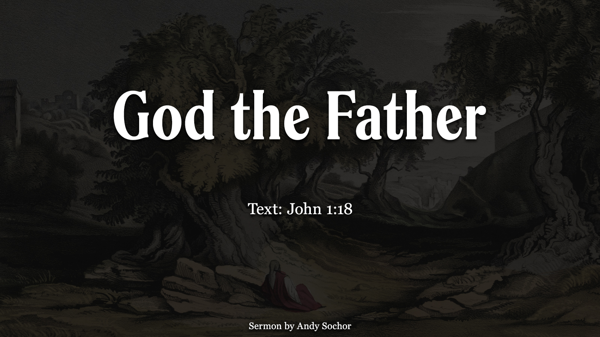

Slide 2
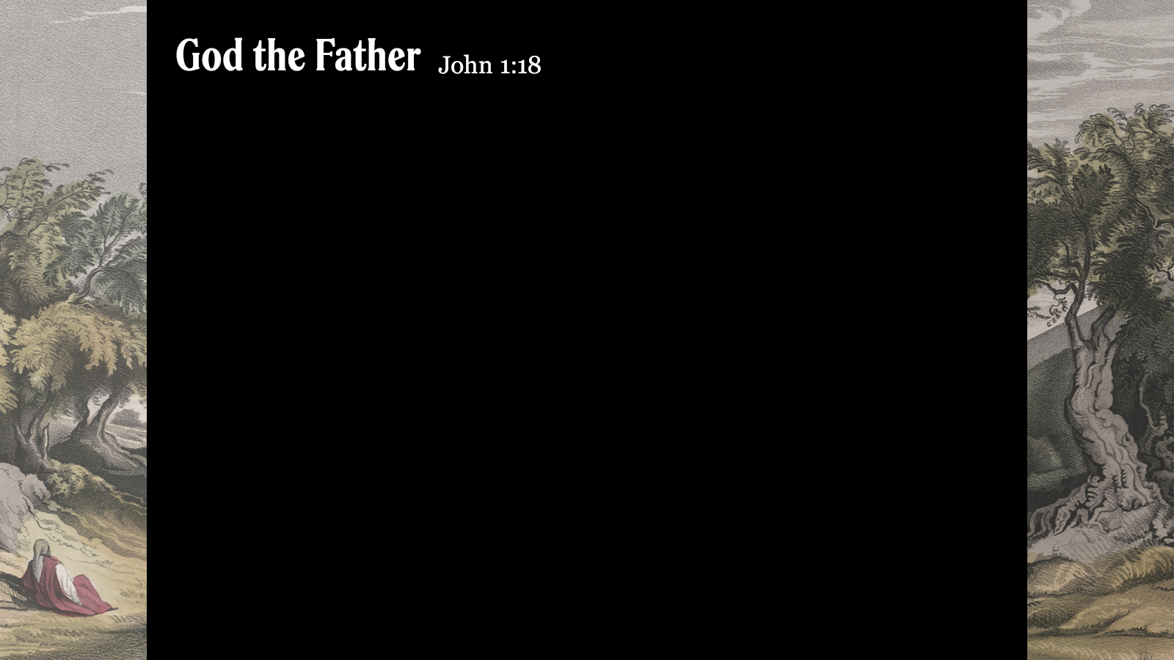
The Father and the Son
The Father loves the Son (Jn. 3:35; cf. Jn. 10:17)
The Father is united with the Son (Jn. 10:30; cf. Jn. 17:20-21)
The Father provides for His Son (Mt. 4:1-4, 11; Mk. 14;35-36)
The Father expects the Son to do His will (Phil. 2:8; Heb. 5:8)
The Father is well-pleased with the Son (Mt. 3:15-17)
The Father does not forsake the Son (Mt. 27:45-46; Ps. 22:1, 16-18, 22-24)

Slide 3
The Father and Us
The Father loves us (Jn. 3:16; cf. Rom. 8:31-37)
The Father is united with us as we walk in the light (1 Jn. 1:7)
The Father provides for us (James 1:17; cf. Mt. 7:7-11)
The Father expects us to do His will (Mt. 7:21-23; cf. Col. 3:17)
The Father is well-pleased with us as we do what pleases Him (Col. 1:10; cf. 2 Tim. 3:16-17)
The Father does not forsake us (Heb. 13:5-6; cf. Rom. 8:35-37)

